Slide 1
PIG
Hadoop Programming Made Easier

Slide 2
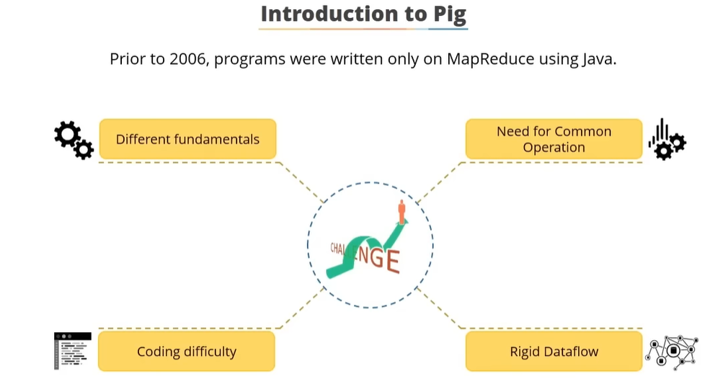

Slide 3
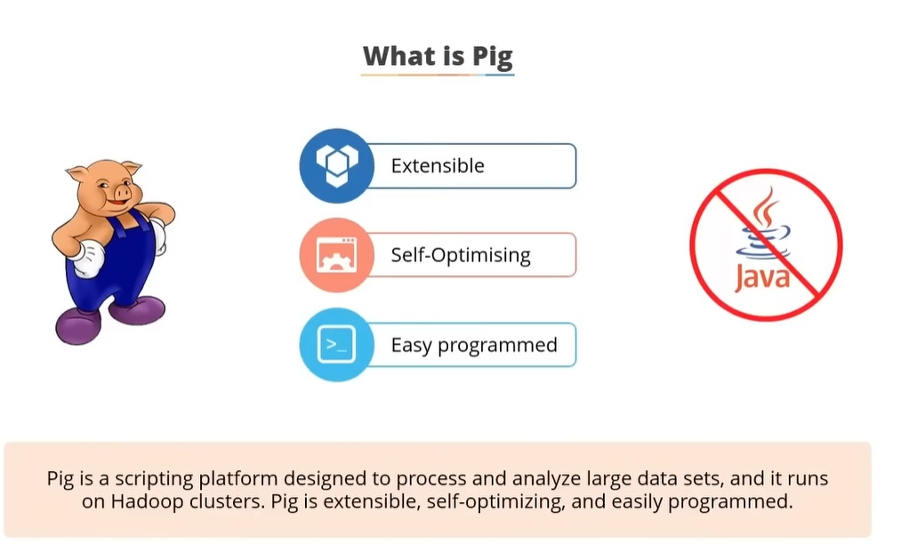

Slide 4
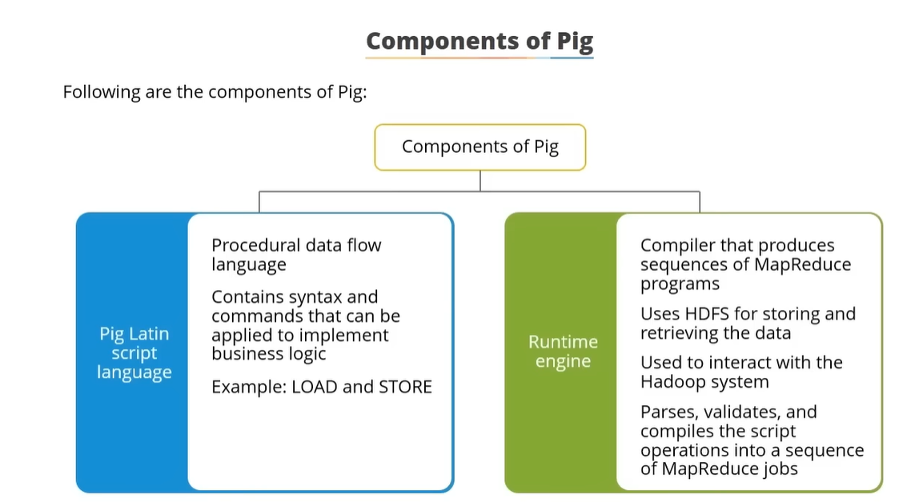

Slide 5
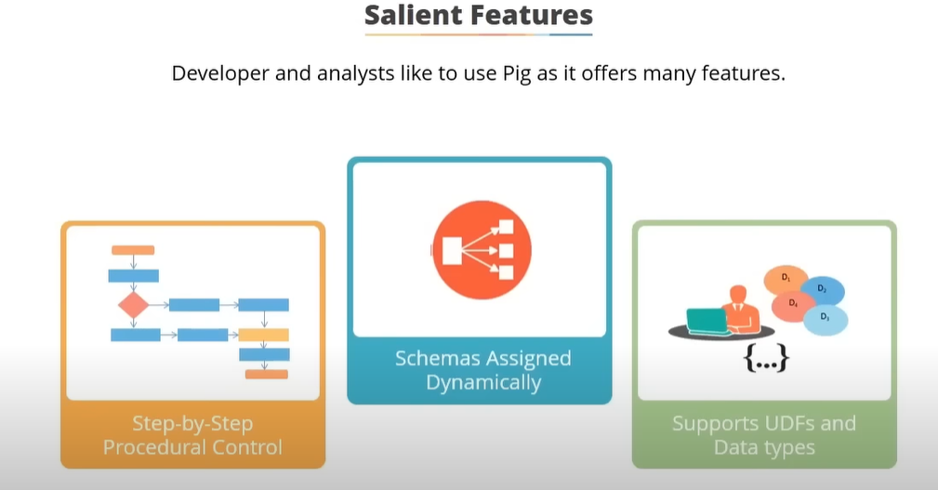

Slide 6
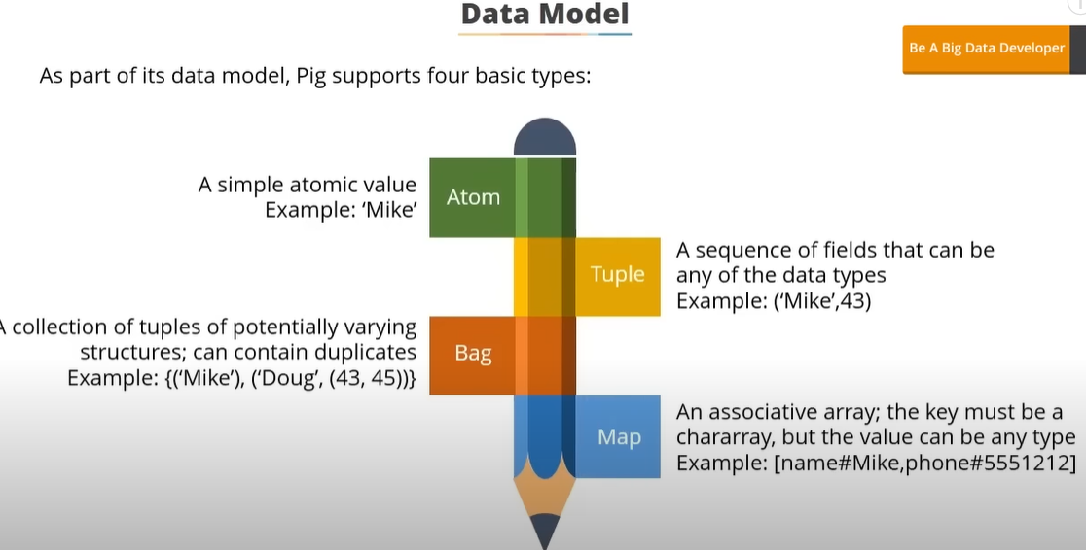


Slide 7
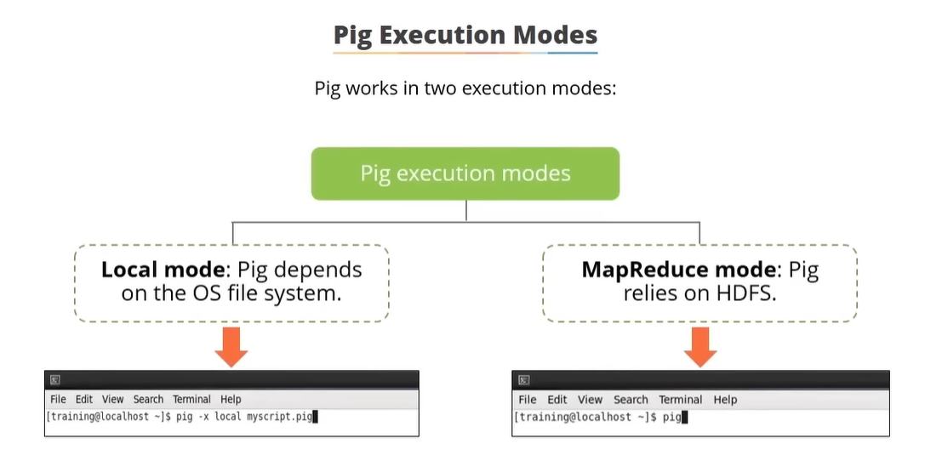

Slide 8
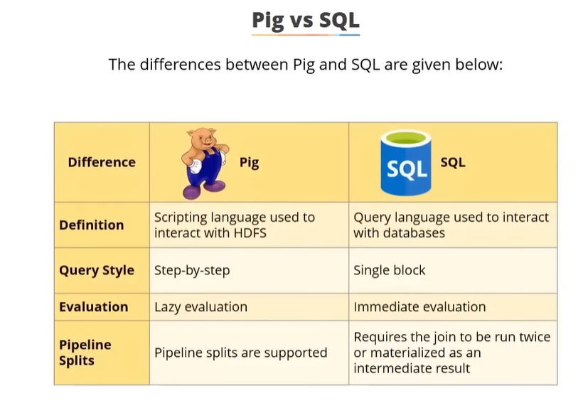

Slide 9
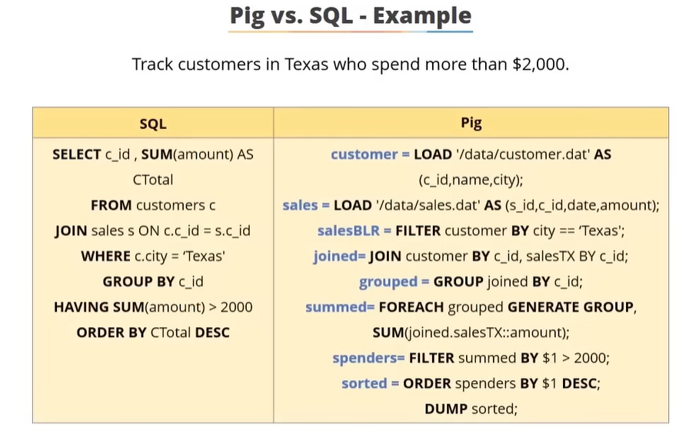

Slide 10
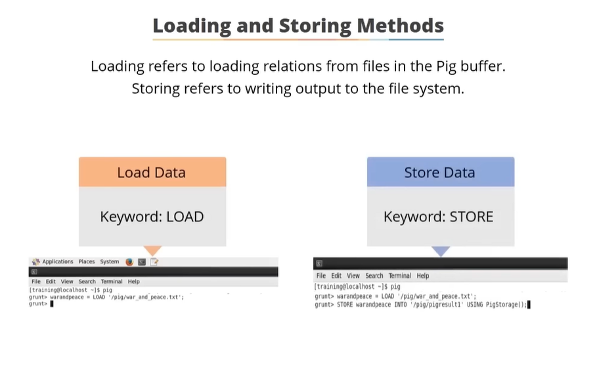

Slide 11
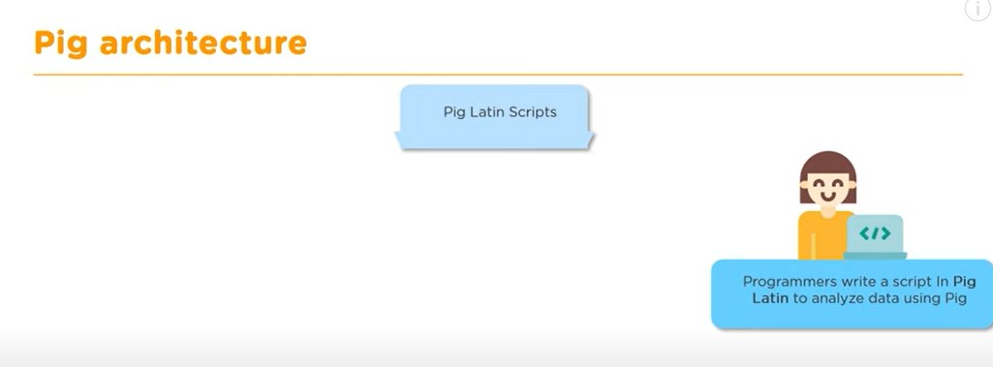
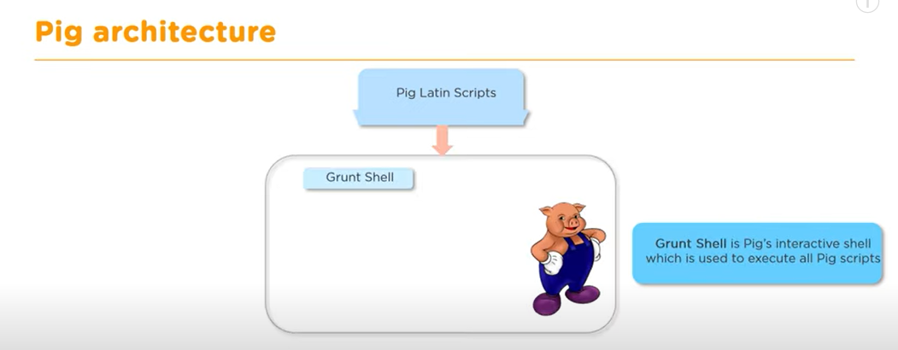

Slide 12
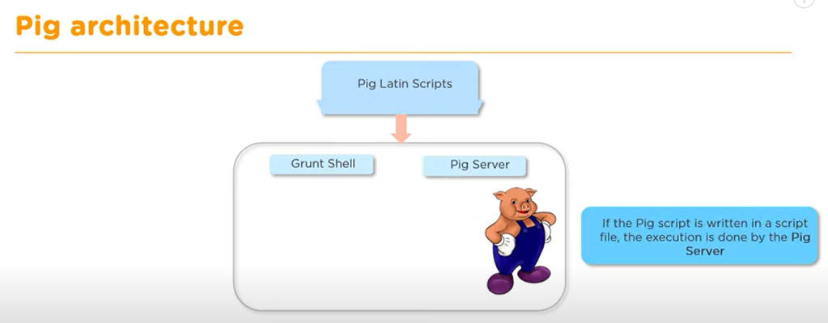
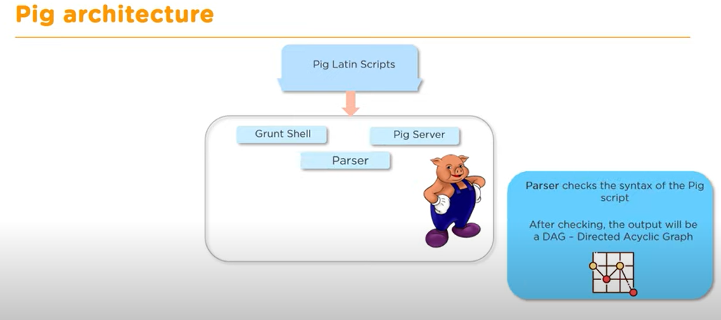

Slide 13
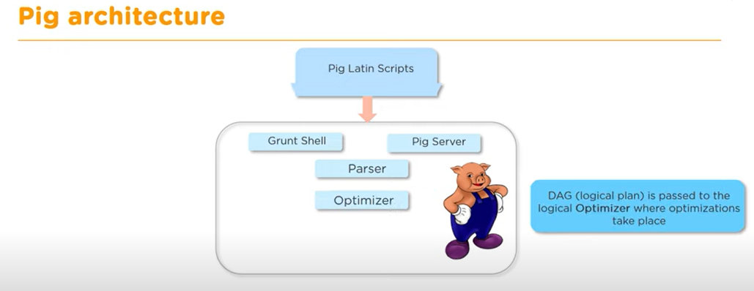
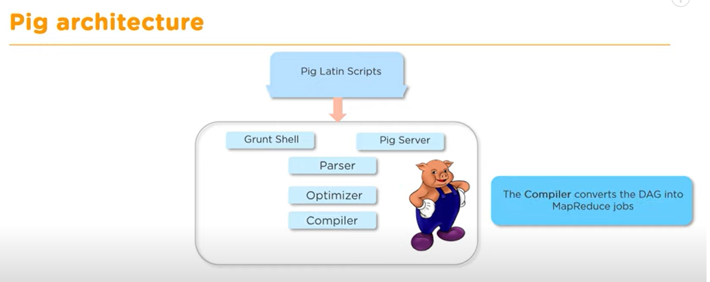

Slide 14
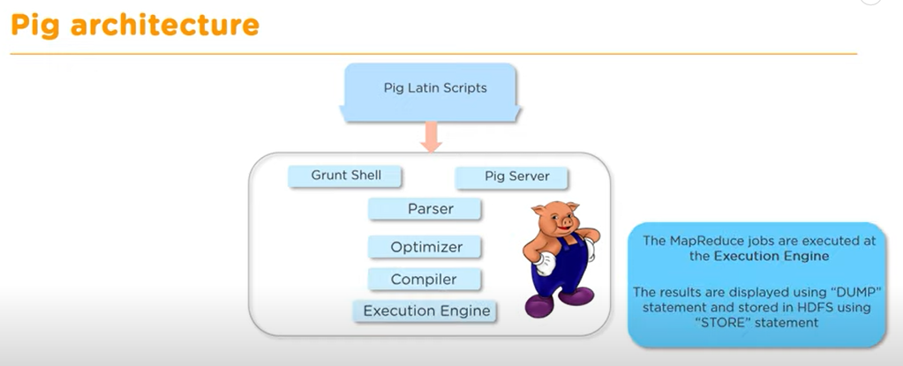

Slide 15
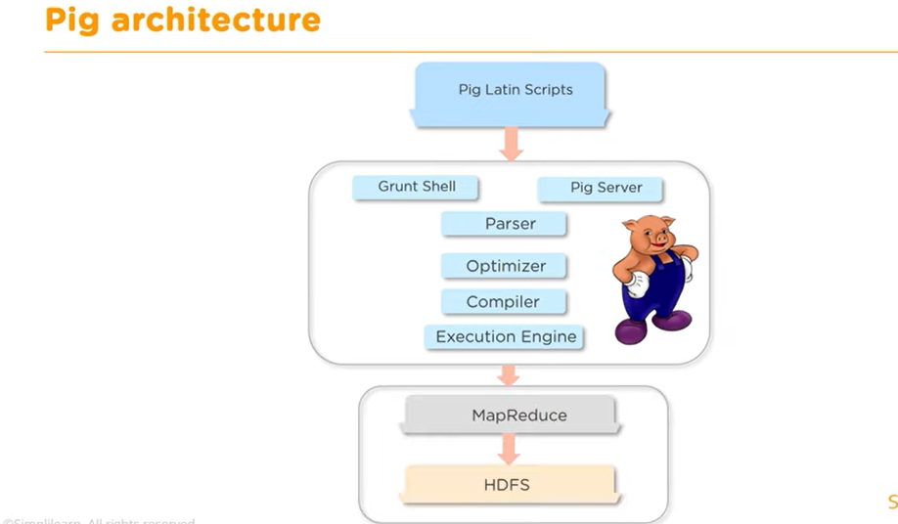


Slide 16
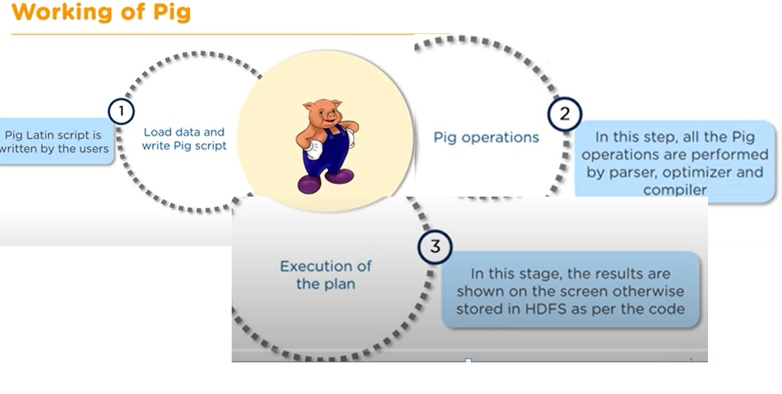

Slide 17
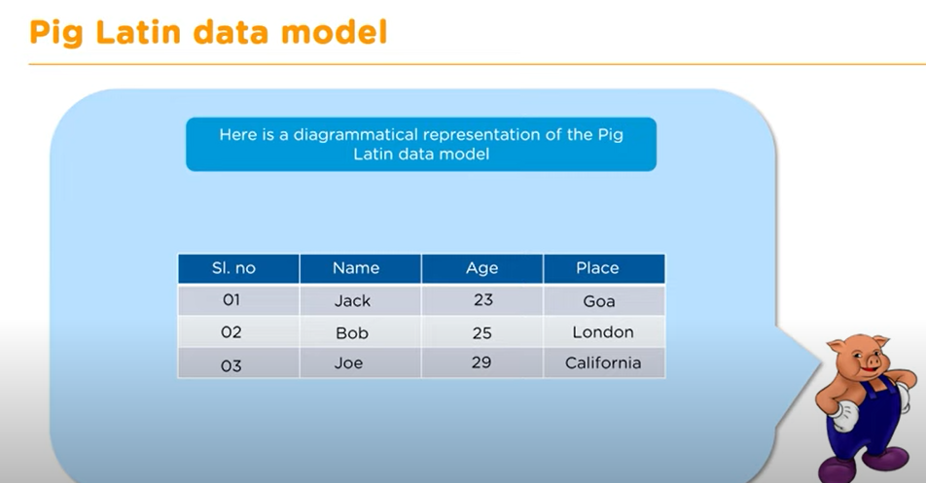
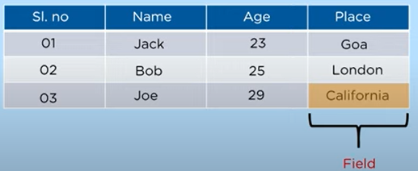
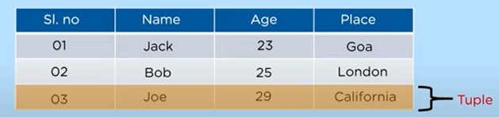
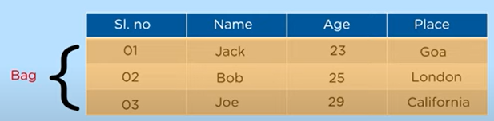

Slide 18
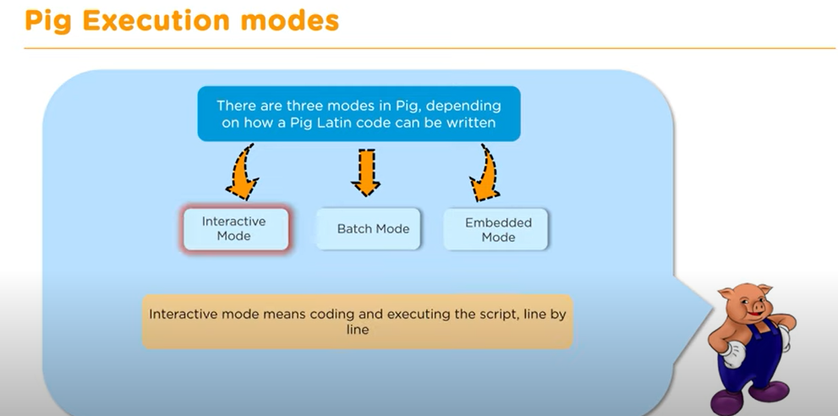

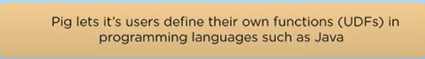

Slide 19
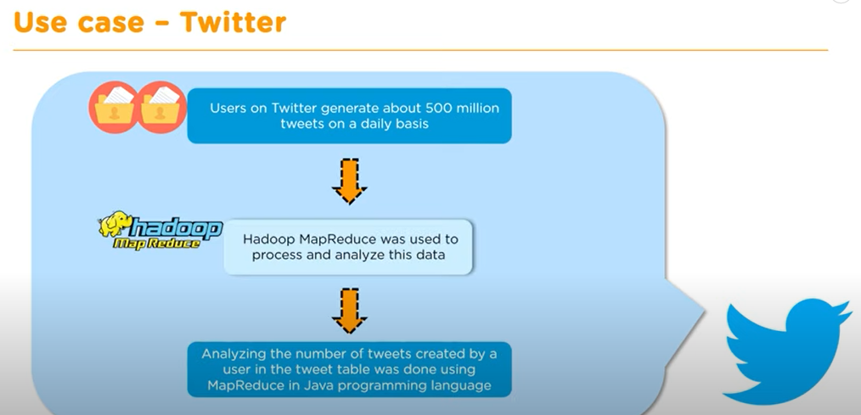

Slide 20
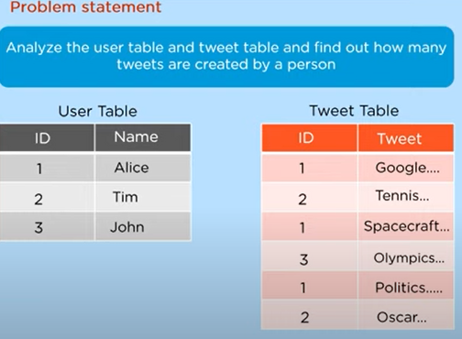


Slide 21
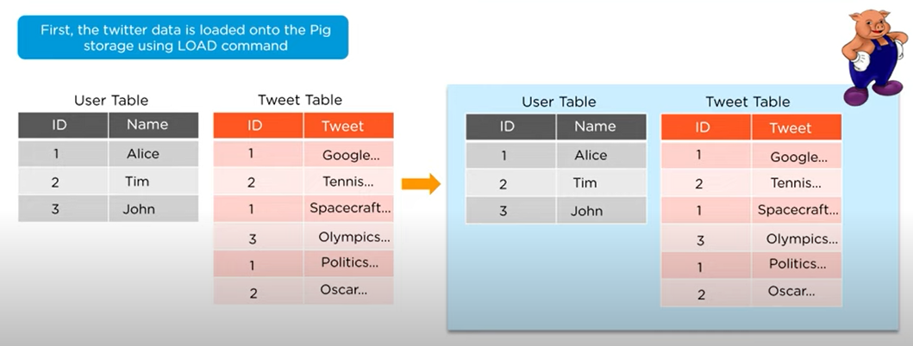
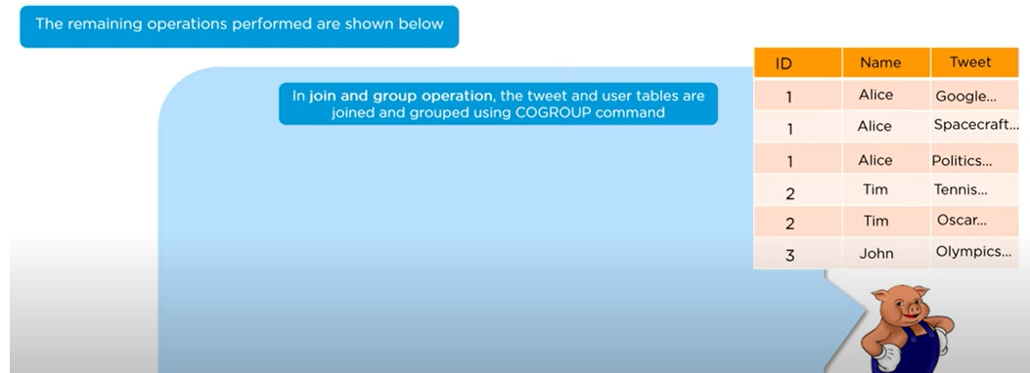

Slide 22
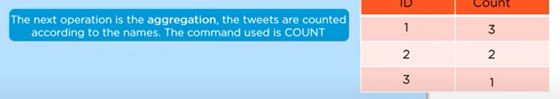
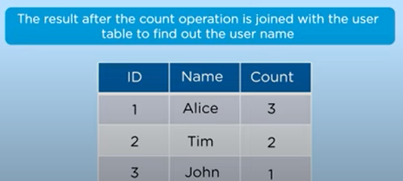
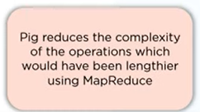


Slide 23
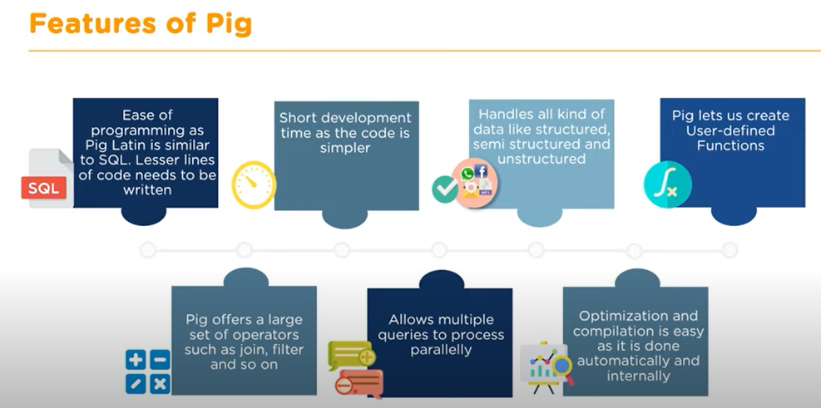

Slide 24
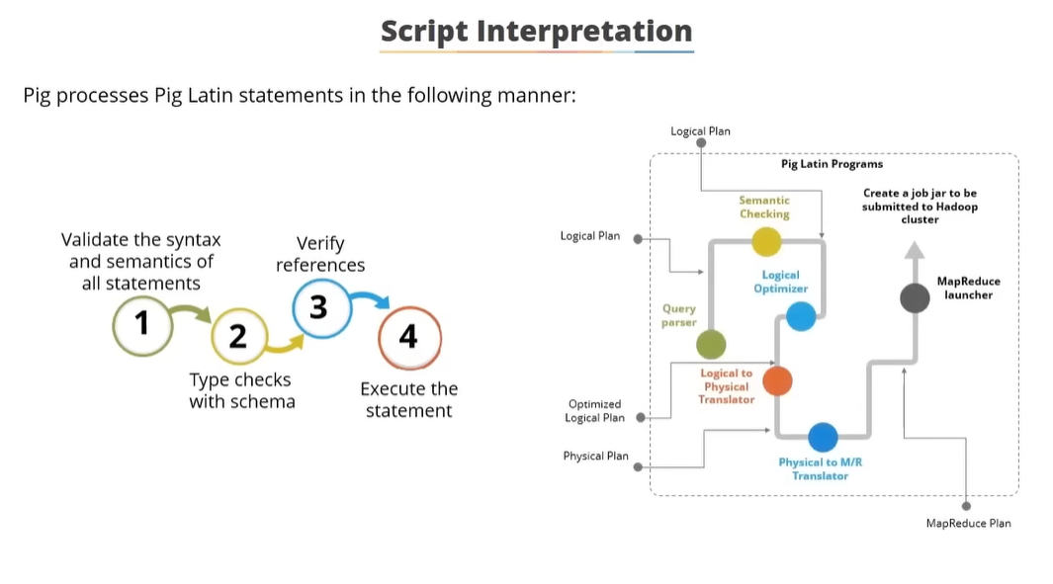

Slide 25
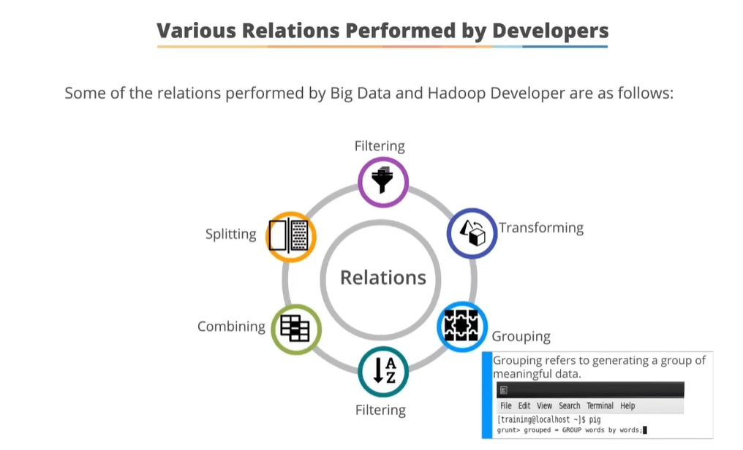

Slide 26
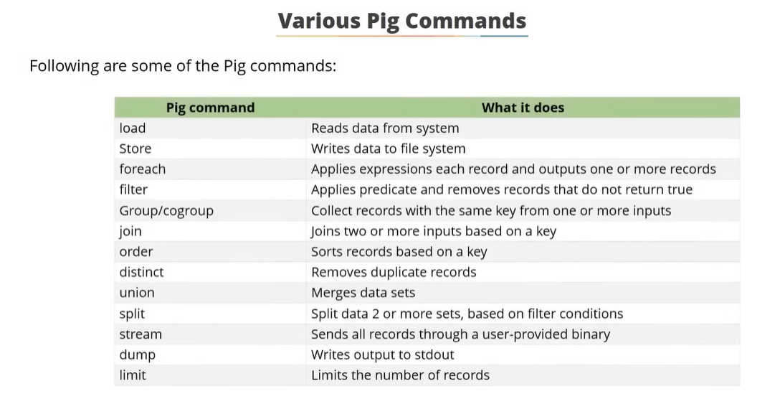

Slide 27
Introduction to PIG
It is a tool/platform which is used to analyze larger sets of data representing them as data flows.
Pig is a high-level data flow platform for executing Map Reduce programs of Hadoop.
It was developed by Yahoo. The language for Pig is pig Latin.
Pig is generally used with Hadoop; we can perform all the data manipulation operations in Hadoop using Apache Pig.

Slide 28
To write data analysis programs, Pig provides a high-level language known as Pig Latin.
This language provides various operators using which programmers can develop their own functions for reading, writing, and processing data.
To analyze data using Apache Pig, programmers need to write scripts using Pig Latin language.
All these scripts are internally converted to Map and Reduce tasks.
Apache Pig has a component known as Pig Engine that accepts the Pig Latin scripts as input and converts those scripts into MapReduce jobs.

Slide 29
Apache Pig uses multi-query approach, thereby reducing the length of codes.
For example, an operation that would require you to type 200 lines of code (LoC) in Java can be easily done by typing as less as just 10 LoC in Apache Pig.
Ultimately Apache Pig reduces the development time by almost 16 times.
Pig Latin is SQL-like language and it is easy to learn Apache Pig when you are familiar with SQL.
Apache Pig provides many built-in operators to support data operations like joins, filters, ordering, etc.
In addition, it also provides nested data types like tuples, bags, and maps that are missing from MapReduce.

Slide 30
Features of Pig
Rich set of operators − It provides many operators to perform operations like join, sort, filer, etc.
Ease of programming − Pig Latin is similar to SQL and it is easy to write a Pig script if you are good at SQL.
Optimization opportunities − The tasks in Apache Pig optimize their execution automatically, so the programmers need to focus only on semantics of the language.
Extensibility − Using the existing operators, users can develop their own functions to read, process, and write data.
UDF’s − Pig provides the facility to create User-defined Functions in other programming languages such as Java and invoke or embed them in Pig Scripts.
Handles all kinds of data − Apache Pig analyzes all kinds of data, both structured as well as unstructured. It stores the results in HDFS.

Slide 31
Configuring PIG
Download Apache Pig
First of all, download the latest version of Apache Pig from the following website − https://pig.apache.org/
Step 1
Open the homepage of Apache Pig website. Under the section News, click on the link release page as shown in the following snapshot.

Slide 32
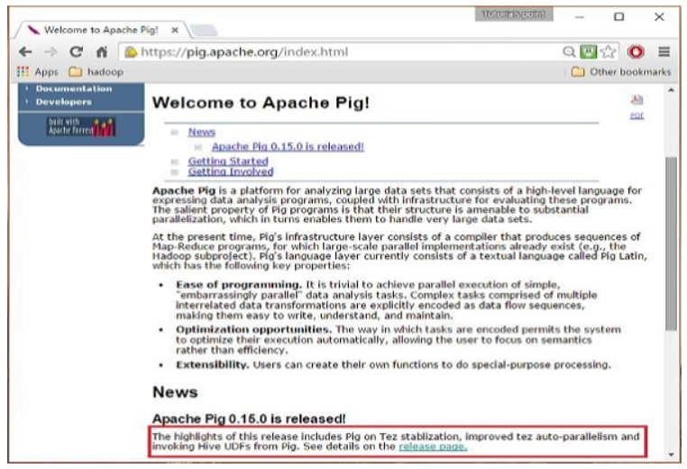

Slide 33
Step 2
On clicking the specified link, you will be redirected to the Apache Pig Releases page. On this page, under the Download section, you will have two links, namely, Pig 0.8 and later and Pig 0.7 and before. Click on the link Pig 0.8 and later, then you will be redirected to the page having a set of mirrors.

Slide 34
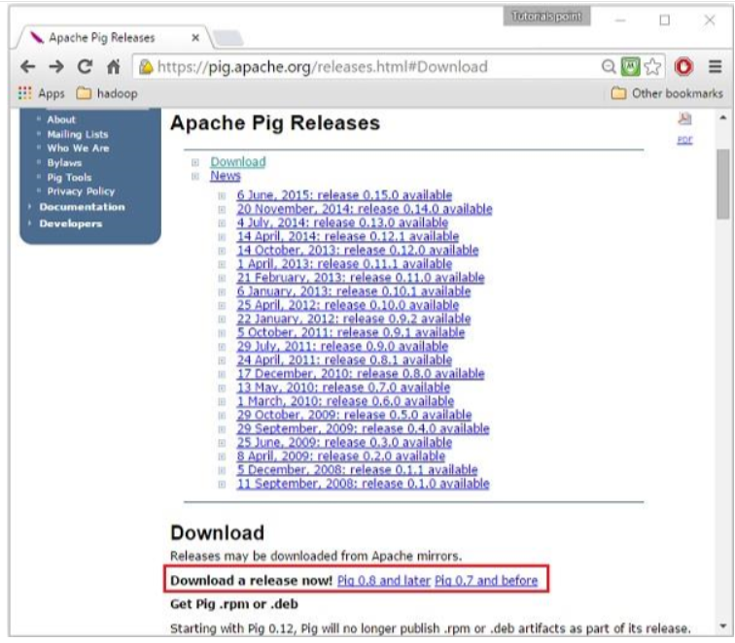

Slide 35


Slide 36
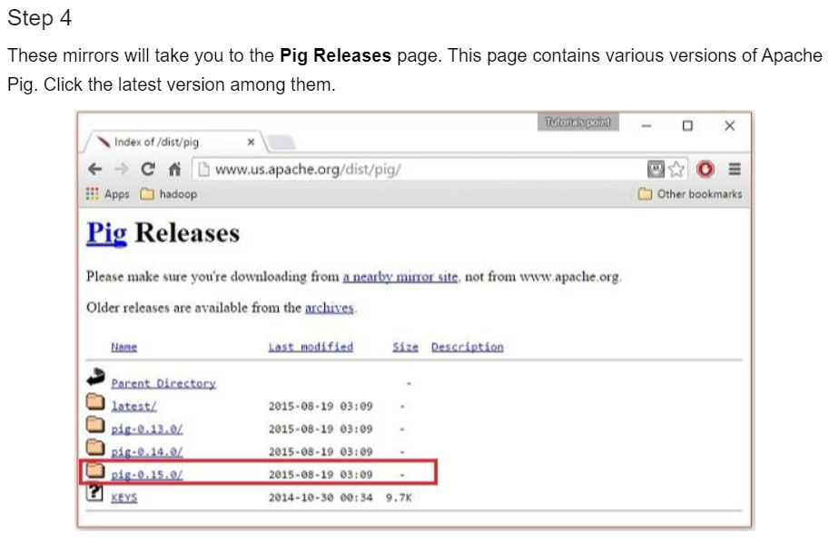

Slide 37
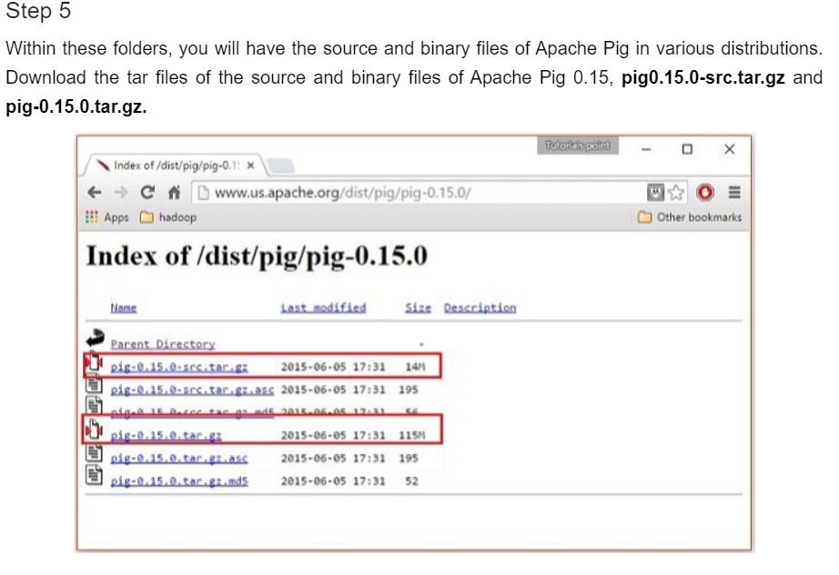

Slide 38
Install Apache Pig
After downloading the Apache Pig software, install it in your Linux environment by following the steps given below.
Step 1
Create a directory with the name Pig in the same directory where the installation directories of Hadoop, Java, and other software were installed. (In our tutorial, we have created the Pig directory in the user named Hadoop).
$ mkdir Pig
Step 2
Extract the downloaded tar files as shown below.
$ cd Downloads/ $ tar zxvf pig-0.15.0-src.tar.gz $ tar zxvf pig-0.15.0.tar.gz
Step 3
Move the content of pig-0.15.0-src.tar.gz file to the Pig directory created earlier as shown below.
$ mv pig-0.15.0-src.tar.gz/* /home/Hadoop/Pig/

Slide 39
Configure Apache Pig
After installing Apache Pig, we have to configure it. To configure, we need to edit two files − bashrc and pig.properties.
.bashrc file
In the .bashrc file, set the following variables −
PIG_HOME folder to the Apache Pig’s installation folder,
PATH environment variable to the bin folder, and
PIG_CLASSPATH environment variable to the etc (configuration) folder of your Hadoop installations (the directory that contains the core-site.xml, hdfs-site.xml and mapred-site.xml files).
export PIG_HOME = /home/Hadoop/Pig export PATH = $PATH:/home/Hadoop/pig/bin export PIG_CLASSPATH = $HADOOP_HOME/conf

Slide 40
Verifying the Installation
Verify the installation of Apache Pig by typing the version command. If the installation is successful, you will get the version of Apache Pig as shown below.
$ pig –version Apache Pig version 0.15.0 (r1682971) compiled Jun 01 2015, 11:44:35

Slide 41
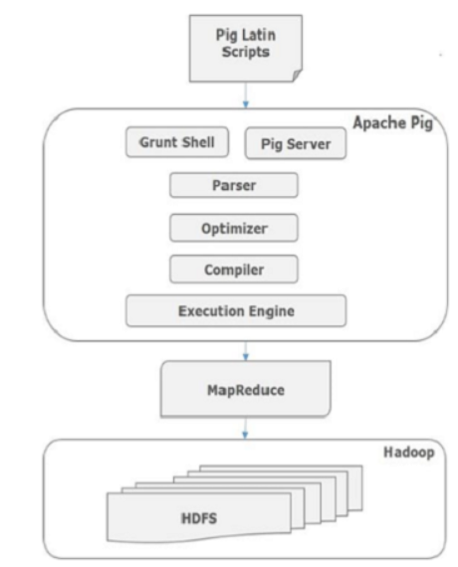
Admiring the PIG Architecture

Slide 42
Apache Pig Components
As shown in the figure, there are various components in the Apache Pig framework. Let us take a look at the major components.
Parser
Initially the Pig Scripts are handled by the Parser. It checks the syntax of the script, does type checking, and other miscellaneous checks. The output of the parser will be a DAG (directed acyclic graph), which represents the Pig Latin statements and logical operators.
In the DAG, the logical operators of the script are represented as the nodes and the data flows are represented as edges.
Optimizer
The logical plan (DAG) is passed to the logical optimizer, which carries out the logical optimizations such as projection and pushdown.

Slide 43
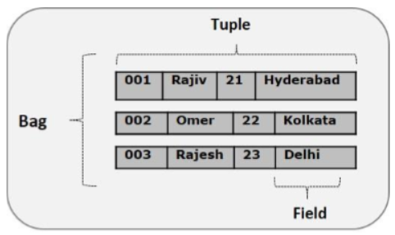
Compiler
The compiler compiles the optimized logical plan into a series of MapReduce jobs.
Execution engine
Finally the MapReduce jobs are submitted to Hadoop in a sorted order. Finally, these MapReduce jobs are executed on Hadoop producing the desired results.
Pig Latin Data Model
The data model of Pig Latin is fully nested and it allows complex non-atomic datatypes such as map and tuple. Given below is the diagrammatical representation of Pig Latin’s data model.

Slide 44
Atom
Any single value in Pig Latin, irrespective of their data, type is known as an Atom. It is stored as string and can be used as string and number. int, long, float, double, chararray, and bytearray are the atomic values of Pig. A piece of data or a simple atomic value is known as a field.
Example − ‘raja’ or ‘30’
Tuple
A record that is formed by an ordered set of fields is known as a tuple, the fields can be of any type. A tuple is similar to a row in a table of RDBMS.
Example − (Raja, 30)

Slide 45
Bag
A bag is an unordered set of tuples. In other words, a collection of tuples (non-unique) is known as a bag.
Each tuple can have any number of fields (flexible schema). A bag is represented by ‘{}’.
It is similar to a table in RDBMS, but unlike a table in RDBMS, it is not necessary that every tuple contain the same number of fields or that the fields in the same position (column) have the same type.
Example − {(Raja, 30), (Mohammad, 45)}
A bag can be a field in a relation; in that context, it is known as inner bag.
Example − {Raja, 30, {9848022338, raja@gmail.com,}}

Slide 46
Map
A map (or data map) is a set of key-value pairs. The key needs to be of type chararray and should be unique. The value might be of any type. It is represented by ‘[]’
Example − [name#Raja, age#30]
Relation
A relation is a bag of tuples. The relations in Pig Latin are unordered (there is no guarantee that tuples are processed in any particular order).

Slide 47
Introduction to grunt shell
Shell Commands
The Grunt shell of Apache Pig is mainly used to write Pig Latin scripts. Prior to that, we can invoke any shell commands using sh and fs.
sh Command
Using sh command, we can invoke any shell commands from the Grunt shell. Using sh command from the Grunt shell, we cannot execute the commands that are a part of the shell environment (ex − cd).
Syntax
Given below is the syntax of sh command.
grunt> sh shell command parameters
Example
We can invoke the ls command of Linux shell from the Grunt shell using the sh option as shown below. In this example, it lists out the files in the /pig/bin/ directory.
grunt> sh ls pig pig_1444799121955.log pig.cmd pig.py

Slide 48
fs Command
Using the fs command, we can invoke any Fs Shell commands from the Grunt shell.
Syntax
grunt> sh File System command parameters
Example
We can invoke the ls command of HDFS from the Grunt shell using fs command. In the following example, it lists the files in the HDFS root directory.
grunt> fs –ls Found 3 items drwxrwxrwx - Hadoop supergroup 0 2015-09-08 14:13 Hbase drwxr-xr-x - Hadoop supergroup 0 2015-09-09 14:52 seqgen_data drwxr-xr-x - Hadoop supergroup 0 2015-09-08 11:30 twitter_data In the same way, we can invoke all the other file system shell commands from the Grunt shell using the fs command.

Slide 49
Utility Commands
The Grunt shell provides a set of utility commands. These include utility commands such as clear, help, history, quit, and set; and commands such as exec, kill, and run to control Pig from the Grunt shell. Given below is the description of the utility commands provided by the Grunt shell.
clear Command
The clear command is used to clear the screen of the Grunt shell.
Syntax
You can clear the screen of the grunt shell using the clear command as shown below.
grunt> clear

Slide 50
history Command
This command displays a list of statements executed / used so far since the Grunt sell is invoked.
Usage
Assume we have executed three statements since opening the Grunt shell.
grunt> customers = LOAD 'hdfs://localhost:9000/pig_data/customers.txt' USING PigStorage(','); grunt> orders = LOAD 'hdfs://localhost:9000/pig_data/orders.txt' USING PigStorage(','); grunt> student = LOAD 'hdfs://localhost:9000/pig_data/student.txt' USING PigStorage(',');

Slide 51
Then, using the history command will produce the following output.
grunt> history customers = LOAD 'hdfs://localhost:9000/pig_data/customers.txt' USING PigStorage(','); orders = LOAD 'hdfs://localhost:9000/pig_data/orders.txt' USING PigStorage(','); student = LOAD 'hdfs://localhost:9000/pig_data/student.txt' USING PigStorage(',');
set Command
The set command is used to show/assign values to keys used in Pig.
Usage
Using this command, you can set values to the following keys.

Slide 52
KeyDescription and values
default_parallel
You can set the number of reducers for a map job by passing any whole number as a value to this key.
Debug
You can turn off or turn on the debugging feature in Pig by passing on/off to this key.
job.name You can set the Job name to the required job by passing a string value to this key.
job.priority You can set the job priority to a job by passing one of the following values to this key −
very_low, low , normal, high , very_high
stream.skippath
For streaming, you can set the path from where the data is not to be transferred, by passing the desired path in the form of a string to this key.

Slide 53
quit Command
You can quit from the Grunt shell using this command.
Usage
Quit from the Grunt shell as shown below.
grunt> quit
Let us now take a look at the commands using which you can control Apache Pig from the Grunt shell.
exec Command
Using the exec command, we can execute Pig scripts from the Grunt shell.
Syntax
Given below is the syntax of the utility command exec.
grunt> exec [–param param_name = param_value] [–param_file file_name] [script]

Slide 54
Example
Let us assume there is a file named student.txt in the /pig_data/ directory of HDFS with the following content.
Student.txt
001,Rajiv,Hyderabad 002,siddarth,Kolkata 003,Rajesh,Delhi And, assume we have a script file named sample_script.pig in the /pig_data/ directory of HDFS with the following content.
Sample_script.pig
student = LOAD 'hdfs://localhost:9000/pig_data/student.txt' USING PigStorage(',') as (id:int,name:chararray,city:chararray); Dump student;Now, let us execute the above script from the Grunt shell using the exec command as shown below.
grunt> exec /sample_script.pig
Output
The exec command executes the script in the sample_script.pig. As directed in the script, it loads the student.txt file into Pig and gives you the result of the Dump operator displaying the following content.
(1,Rajiv,Hyderabad) (2,siddarth,Kolkata) (3,Rajesh,Delhi)

Slide 55
kill Command
You can kill a job from the Grunt shell using this command.
Syntax
Given below is the syntax of the kill command.
grunt> kill JobId Example
Suppose there is a running Pig job having id Id_0055, you can kill it from the Grunt shell using the kill command, as shown below.
grunt> kill Id_0055
run Command
You can run a Pig script from the Grunt shell using the run command
Syntax
Given below is the syntax of the run command.
grunt> run [–param param_name = param_value] [–param_file file_name] script Example
Let us assume there is a file named student.txt in the /pig_data/ directory of HDFS with the following content.
Student.txt
001,Rajiv,Hyderabad 002,siddarth,Kolkata 003,Rajesh,Delhi

Slide 56
Sample_script.pig
student = LOAD 'hdfs://localhost:9000/pig_data/student.txt' USING PigStorage(',') as (id:int,name:chararray,city:chararray);Now, let us run the above script from the Grunt shell using the run command as shown below.
grunt> run /sample_script.pig You can see the output of the script using the Dump operator as shown below.
grunt> Dump; (1,Rajiv,Hyderabad) (2,siddarth,Kolkata) (3,Rajesh,Delhi)

Slide 57
Going with the pig Latin Application Flow
Pig Latin is a dataflow language, where we define a data stream and a series of transformations that are applied to the data as it flows through our application.
This is in contrast to a control flow language (like C or Java), where we write a series of instructions.
In control flow languages, we use constructs like loops and conditional logic (like an if statement).
We won’t find loops and if statements in Pig Latin. Here is a simple pig syntax :
A = LOAD 'mindstick_file.txt';...B = GROUP ... ;...C= FILTER ...;...DUMP B;..STORE C INTO 'Results';

Slide 58
Load:
We first load (LOAD) the data we want to manipulate. As in a typical MapReduce job, that data is stored in HDFS. For a Pig program to access the data, we first tell Pig what file or files to use. For that task, we use the LOAD 'data_file' command.
Here, 'mindstick_file' can specify either an HDFS data file or a HDFS directory. If a directory is specified, every file located in that directory are loaded into the program.
If the data is stored in a file format that isn’t natively accessible to Pig, we can optionally add the USING function to the LOAD statement to specify a user-defined function that can read in (and interpret) the data.

Slide 59
Transform: We run the data through a set of transformations that, way under the hood and far removed from anything we have to concern ourselves with, are translated into a set of Map and Reduce tasks. The transformation logic is place where all the data manipulation processing happens.
Here, we can FILTER out rows that aren’t of our interest, JOIN two sets of data files, GROUP data to build aggregations, ORDER results, and do many more things.
Dump: Finally, we dump (DUMP) the results to the screen
Or Store (STORE) the results in a file somewhere.

Slide 60
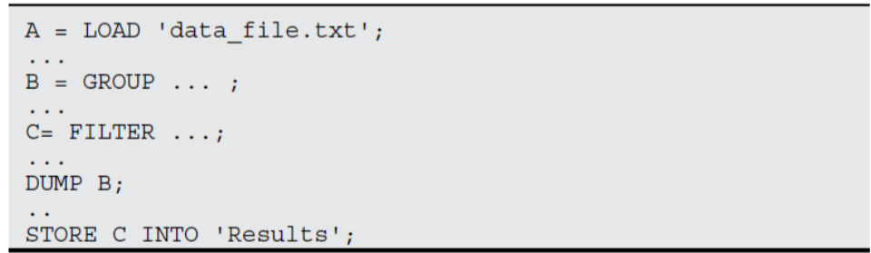
Listing: Sample pig code to illustrate the data processing data flow
Some of the text in this example actually looks like English. Looking at each line in turn, you can see the basic flow of a Pig program. This code can either be part of a script or issued on the interactive shell called
Grunt.
Load:
You first load (LOAD) the data you want to manipulate. As in a typical MapReduce job, that data is stored in HDFS.

Slide 61
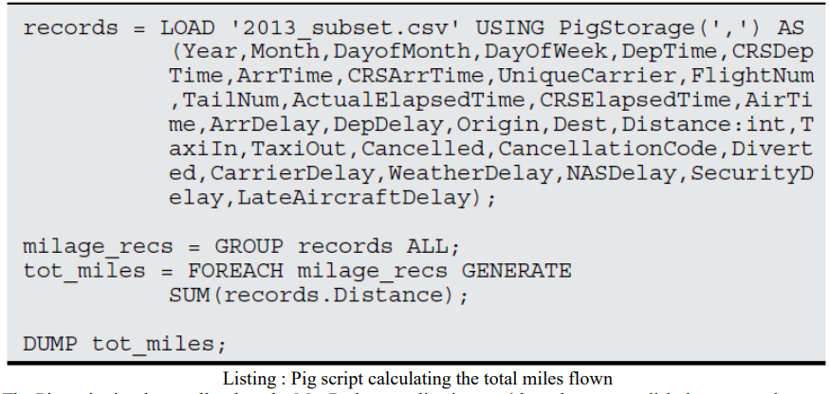
Uncovering Pig Latin Structures
The problem we‘re trying to solve involves calculating the total number of flights flown by every carrier.
Following listing is the Pig Latin script we‘ll use to answer this question

Slide 62
The Pig script is a lot smaller than the MapReduce application you‘d need to accomplish the same task — the Pig script only has 4 lines of code.
And not only is the code shorter, but it‘s even semi-human readable. Most Pig scripts start with the LOAD statement to read data from HDFS.
In this case, we‘re loading data from a .csv file. Pig has a data model it uses, so next we need to map the file‘s data model to the Pig data mode.
This is accomplished with the help of the USING statement.
We then specify that it is a comma-delimited file with the PigStorage(',') statement followed by the AS statement defining the name of each of the columns.

Slide 63
Aggregations are commonly used in Pig to summarize data sets. The GROUP statement is used to aggregate the records into a single record mileage_recs.
The ALL statement is used to aggregate all tuples into a single group.
Note that some statements — including the following SUM statement — requires a preceding GROUP ALL statement for global sums.
FOREACH . . . GENERATE statements are used here to transformcolumns data In this case, we want to count the miles traveled in the records_Distance column.
The SUM statement computes the sum of the record_Distance column into a single-column collection total_miles.

Slide 64
The DUMP operator is used to execute the Pig Latin statement and display the results on the screen.
DUMP is used in interactive mode, which means that the statements are executable immediately and the results are not saved.
Typically, you will either use the DUMP or STORE operators at the end of your Pig script.
Most Pig scripts start with the LOAD statement to read data from HDFS.
In this case, we‘re loading data from a .csv file. Pig has a data model it uses, so next we need to map the file‘s data model to the Pig data mode. This is accomplished with the help of the USING statement. We then specify that it is a comma-delimited file with the PigStorage(',') statement followed by the AS statement defining the name of each of the columns.

Slide 65
Aggregations are commonly used in Pig to summarize data sets.
The GROUP statement is used to aggregate the records into a single record mileage_recs. The ALL statement is used to aggregate all tuples into a single group. Note that some statements — including the following SUM statement — requires a preceding GROUP ALL statement for global sums.
FOREACH . . . GENERATE statements are used here to transformcolumns data In this case, we want to count the miles traveled in the records_Distance column. The SUM statement computes the sum of the record_Distance column into a single-column collection total_miles.
The DUMP operator is used to execute the Pig Latin statement and display the results on the screen.
DUMP is used in interactive mode, which means that the statements are executable immediately and the results are not saved. Typically, you will either use the DUMP or STORE operators at the end of your Pig script.

Slide 66
Looking at PIG data Types and Syntax
Looking at Pig data types and syntax Pig‘s data types make up the data model for how Pig thinks of the structure of the data it is processing.
With Pig, the data model gets defined when the data is loaded.
Any data you load into Pig from disk is going to have a particular schema and structure.
In general terms, though, Pig data types can be broken into two
categories: scalar types and complex types.
Scalar types contain a single value, whereas complex types contain other types, such as the Tuple, Bag, and Map types.

Slide 67
Pig Latin has these four types in its data model:
Atom: An atom is any single value, such as a string or a number — ‗Diego‘, for example. Pig‘s atomic values are scalar types that appear in most programming languages — int, long, float, double, chararray, and bytearray, for example. See Figure 2 to see sample atom types.
Tuple: A tuple is a record that consists of a sequence of fields. Each field can be of any type — ‗Diego‘, ‗Gomez‘, or 6, for example. Think of a tuple as a row in a table.
Bag: A bag is a collection of non-unique tuples. The schema of the bag is flexible — each tuple in the collection can contain an arbitrary number of fields, and each field can be of any type.

Slide 68
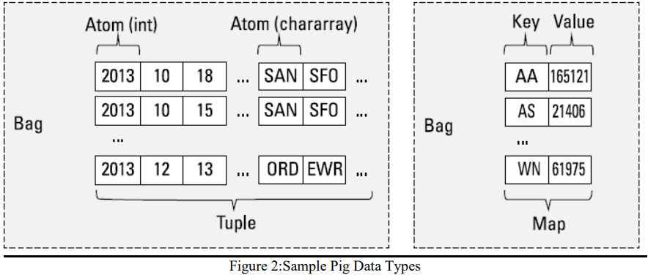
Map: A map is a collection of key value pairs. Any type can be stored in the value, and the key needs to be unique.
The key of a map must be a chararray and the value can be of any type.
Figure -2 offers some fine examples of Tuple, Bag, and Map data types, as well

Slide 69
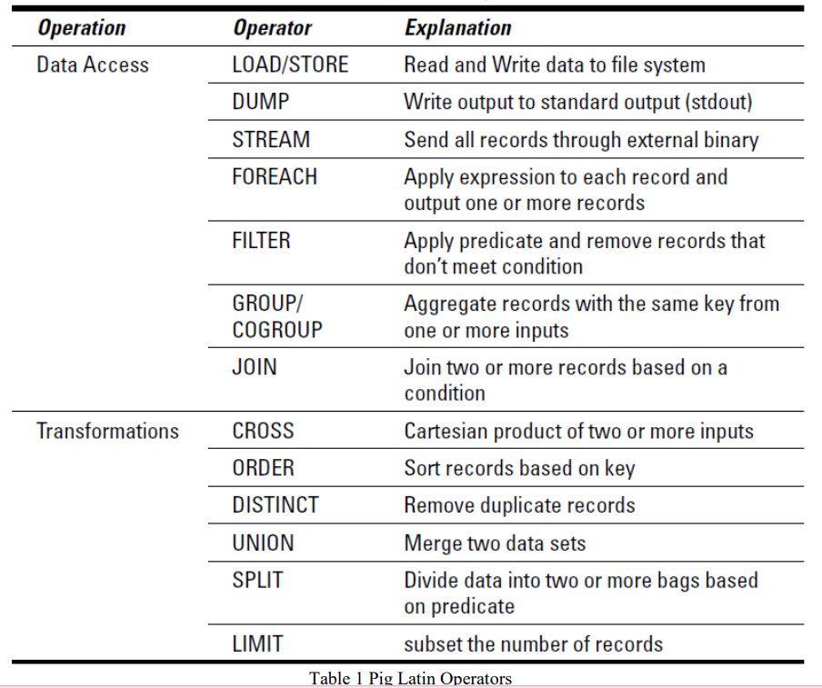
In a Hadoop context, accessing data means allowing developers to load, store, and stream data, whereas transforming data means taking advantage of Pig‘s ability to group, join, combine, split, filter, and sort data.
Table 1 gives an overview of the operators associated with each operation.

Slide 70
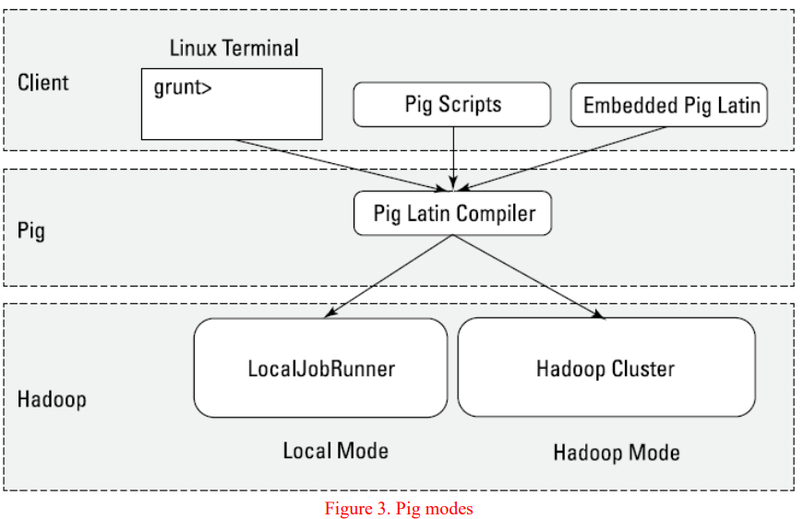
Evaluating Local and Distributed Modes of Running Pig Scripts

Slide 71
Local mode
All scripts are run on a single machine without requiring Hadoop MapReduce and HDFS.
This can be useful for developing and testing Pig logic.
If you‘re using a small set of data to develope or test your code, then local mode could be faster than going through the MapReduce infrastructure.
Local mode doesn‘t require Hadoop.
When you run in Local mode, the Pig program runs in the context of a local Java Virtual Machine, and data access is via the local file system of a single machine.
Local mode is actually a local simulation of MapReduce in Hadoop‘s LocalJobRunner class.

Slide 72
MapReduce mode (also known as Hadoop mode) Pig is executed on the Hadoop cluster.
In this case, the Pig script gets converted into a series of MapReduce jobs that are then run on the Hadoop cluster.
If you have a terabyte of data that you want to perform operations on and you want to interactively develop a program, you may soon find things slowing down considerably, and you may start growing your storage.
Local mode allows you to work with a subset of your data in a more interactive manner so that you can figure out the logic (and work out the bugs) of your Pig program.
After you have things set up as you want them and your operations are running smoothly, you can then run the script against the full data set using MapReduce mode.

Slide 73
Checking Out the Pig Script Interfaces
Pig programs can be packaged in three different ways:
Script:
This method is nothing more than a file containing Pig Latin commands, identified by the .pig suffix (FlightData.pig, for example).
Ending your Pig program with the .pig extension is a convention but not required.
The commands are interpreted by the Pig Latin compiler and executed in the order determined by the Pig optimizer.
Grunt: Grunt acts as a command interpreter where you can interactively enter Pig Latin at the Grunt command line and immediately see the response.
This method is helpful for prototyping during initial development and with what-if scenarios.
Embedded: Pig Latin statements can be executed within Java, Python, or JavaScript programs.

Slide 74
Pig scripts, Grunt shell Pig commands, and embedded Pig programs can run in either Local mode or MapReduce mode.
The Grunt shell provides an interactive shell to submit Pig commands or run Pig scripts.
To start the Grunt shell in Interactive mode, just submit the command pig at your shell.
To specify whether a script or Grunt shell is executed locally or in Hadoop mode just specify it in the –x flag to the pig command.
The following is an example of how you‘d specify running your Pig script in local mode:
pig -x local milesPerCarrier.pig Here‘s how you‘d run the Pig script in Hadoop mode, which is the default if you don‘t specify the flag: pig -x mapreduce milesPerCarrier.
pig By default, when you specify the pig command without any parameters, it starts the Grunt shell in Hadoop mode.
If you want to start the Grunt shell in local mode just add the –x local flag to the command. Here is an example: pig -x local

Slide 75
Checking out the Pig Scripts Interfaces
Scripting with Pig Latin
Hadoop is a rich and quickly evolving ecosystem with a growing set of new applications.
Rather than try to keep up with all the requirements for new capabilities, Pig is designed to be extensible via user-defined functions, also known as UDFs.
UDFs can be written in a number of programming languages, including Java, Python, and JavaScript.
Developers are also posting and sharing a growing collection of UDFs online. (Look for Piggy Bank and DataFu, to name just two examples of such online collections.) Some of the Pig UDFs that are part of these repositories are LOAD/STORE functions (XML, for example), date time functions, text, math, and stats functions.
Pig can also be embedded in host languages such as Java, Python, and JavaScript, which allows you to integrate Pig with your existing applications.

Slide 76
It also helps overcome limitations in the Pig language.
One of the most commonly referenced limitations is that Pig doesn‘t support control flow statements: if/else, while loop, for loop, and condition statements.
Pig natively supports data flow, but needs to be embedded within another language to provide control flow.
There are tradeoffs, however of embedding Pig in a control-flow language.
For example if a Pig statement is embedded in a loop, every time the loop iterates and runs the Pig statement, this causes a separate MapReduce job to run.

Slide 77
Pig Represents Big Data as data flows.
Pig is a high-level platform or tool which is used to process the large datasets.
It provides a high-level of abstraction for processing over the MapReduce.
It provides a high-level scripting language, known as Pig Latin which is used to develop the data analysis codes.
First, to process the data which is stored in the HDFS, the programmers will write the scripts using the Pig Latin Language.

Slide 78
Internally Pig Engine(a component of Apache Pig) converted all these scripts into a specific map and reduce task.
But these are not visible to the programmers in order to provide a high-level of abstraction.
Pig Latin and Pig Engine are the two main components of the Apache Pig tool. The result of Pig always stored in the HDFS.
Pig Engine has two type of execution environment i.e. a local execution environment in a single JVM (used when dataset is small in size)and distributed execution environment in a Hadoop Cluster.

Slide 79
Need of Pig: One limitation of MapReduce is that the development cycle is very long.
Writing the reducer and mapper, compiling packaging the code, submitting the job and retrieving the output is a time-consuming task.
Apache Pig reduces the time of development using the multi-query approach. Also, Pig is beneficial for programmers who are not from Java background.
200 lines of Java code can be written in only 10 lines using the Pig Latin language.
Programmers who have SQL knowledge needed less effort to learn Pig Latin.

Slide 80
It uses query approach which results in reducing the length of the code.
Pig Latin is SQL like language.
It provides many builtIn operators.
It provides nested data types (tuples, bags, map).

Slide 81
Evolution of Pig: Earlier in 2006, Apache Pig was developed by Yahoo’s researchers.
At that time, the main idea to develop Pig was to execute the MapReduce jobs on extremely large datasets.
In the year 2007, it moved to Apache Software Foundation(ASF) which makes it an open source project.
The first version(0.1) of Pig came in the year 2008.
The latest version of Apache Pig is 0.18 which came in the year 2017.

Slide 82
Features of Apache Pig:
For performing several operations Apache Pig provides rich sets of operators like the filtering, joining, sorting, aggregation etc.
Easy to learn, read and write. Especially for SQL-programmer, Apache Pig is a boon.
Apache Pig is extensible so that you can make your own process and user-defined functions(UDFs) written in python, java or other programming languages .
Join operation is easy in Apache Pig.

Slide 83
Fewer lines of code.
Apache Pig allows splits in the pipeline.
By integrating with other components of the Apache Hadoop ecosystem, such as Apache Hive, Apache Spark, and Apache ZooKeeper, Apache Pig enables users to take advantage of these components’ capabilities while transforming data.
The data structure is multivalued, nested, and richer.
Pig can handle the analysis of both structured and unstructured data.

Slide 84
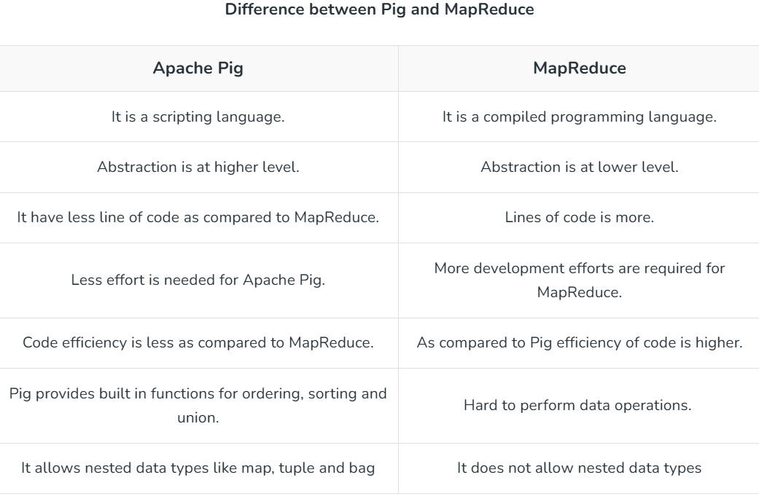

Slide 85
Applications of Apache Pig:
For exploring large datasets Pig Scripting is used.
Provides the supports across large data-sets for Ad-hoc queries.
In the prototyping of large data-sets processing algorithms.
Required to process the time sensitive data loads.
For collecting large amounts of datasets in form of search logs and web crawls.
Used where the analytical insights are needed using the sampling.

Slide 86
Types of Data Models in Apache Pig: It consist of the 4 types of data models as follows:
Atom: It is a atomic data value which is used to store as a string. The main use of this model is that it can be used as a number and as well as a string.
Tuple: It is an ordered set of the fields.
Bag: It is a collection of the tuples.
Map: It is a set of key/value pairs.

